Slide 1
Stratified Approach Using Conditional Random Fields for Diagnosis Of Intrusions

Slide 2
Abstract
An intrusion detection system must reliably detect malicious activities in a network and must perform efficiently to cope with the large amount of network traffic.
High attack detection accuracy can be achieved by using Conditional Random Fields (CRF) and high efficiency by implementing the Layered Approach.
.

Slide 3
Introduction
Intrusion detection systems are classified as network based, host based, or application based depending on their mode of deployment and data used for analysis .
Additionally, intrusion detection systems can also be classified as signature based or anomaly based depending upon the attack detection .

Slide 4
Impact of intrusions
The impact of occurrence of intrusions may lead to the loss of confidentiality of data that exists.
It may lead to violation of the system vulnerabilities.
ACID properties such as availability, confidentiality, integrity, durability of the data may not be ensured due to the occurrence of intrusions.

Slide 5
Software Requirements
Front End : JAVA, RMI, Swing
Back End : JDBC
Java is being used to implement the modules such a way that it can be accessed on any system .
Java Data Base Connectivity is used to connect through the database in order to access the data from it where data is stored ensuring that authorized access is done.
Remote Method Invocation(RMI) is being used for the accessing of the resources through implementing client server environment.

Slide 6
Existing System
To detect intrusions association rules, clustering, naive Bayes classifier, support vector machines, genetic algorithms, artificial neural networks are adapted.
The drawback of such frameworks is that they tend to produce a large number of rules and thereby, increase the complexity of the system.

Slide 7
Proposed System
Every layer in the Layered Intrusion Detection System (LIDS) framework is trained separately and then deployed sequentially. Four layers that correspond to the four attack groups are being defined.

Slide 8
MODULES
Conditional Random Field
DOS layer(Denial of Service)
Probe Layer
R2L Layer(Remote to Local)

Slide 9
ALGORITHM
Step 1: choose the four layers
Step 2: perform various options on every layer
Step 3:once the input is given the corresponding CRF measure is considered
Step 5: check for every input from step 3 to 7
Step 6: determine whether instance is normal or attack.
Step 7: If the occurrence is identified as intrusion, avoid it and identify it as an intrusion by the layer name at that it's detected and visit Step five. Else pass the sequence to ensuring layer.

Slide 10
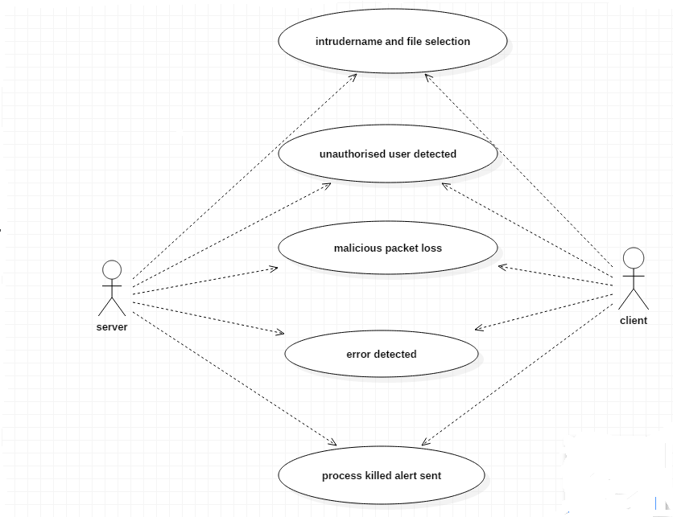
System Design
Usecase Diagram:

Slide 11
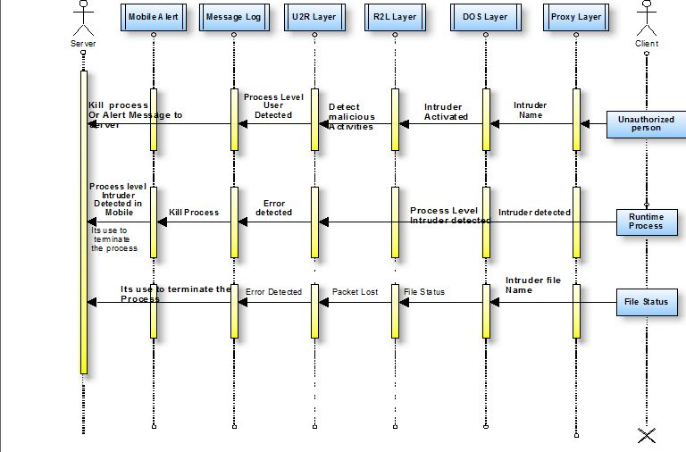
Sequence Diagram

Slide 12
Conclusion
Finally, proposed system has the advantage that the number of layers can be increased or decreased depending upon the environment in which the system is deployed, giving flexibility to the network administrators.
The areas for future research include the use of our method for extracting features that can aid in the development of signatures for signature-based systems. The signature-based systems can be deployed at the periphery of a network to filter out attacks that are frequent and previously known, leaving the detection of new unknown attacks for anomaly and hybrid systems.

Slide 13
References
1.. Lee, S. Stolfo, and K. Mok, “Mining Audit Data to Build Intrusion Detection Models,” Proc. Fourth Int’l Conf. Knowledge Discovery and Data Mining (KDD ’98), pp. 66-72, 1998.
2.. Puketza, Nicholas Joseph (2000). Approaches to Computer Security: Filtering, Testing, and Detection. California: University of California.
3.Suman Bharti, Dr. Savita shiwani, Dinesh Goyal, Vinit Agrawal Jaipur, India India,. Intrusion Detection System (IDS) Using Layered Based Approach For Finding Attack. Issue No.8, pp : 1082-1084

Slide 14
References(cont…)
4.A. McCallum, D. Freitag, and F. Pereira, “Maximum Entropy Markov Models for Information Extraction and Segmentation,” Proc. 17th Int’l Conf. Machine Learning (ICML ’00), pp. 591598,2000.
5. N.B. Amor, S. Benferhat, and Z. Elouedi, “Naive Bayes vs. Decision Trees in Intrusion Detection Systems,” Proc. ACM Symp. Applied Computing (SAC ’04), pp. 420-424, 2004.
6. D.S. Kim and J.S. Park, “Network-Based Intrusion Detection with Support Vector Machines,” Proc. Information Networking, Networking Technologies for Enhanced Internet Services Int’l Conf. (ICOIN ’03), pp. 747-756, 2003.
7. R. Agrawal, T. Imielinski, and A. Swami, (1993)“Mining Association Rules between Sets of Items in Large Databases”, Proc. ACM SIGMOD, vol. 22, no. 2, pp. 207-216.
8. K.K. Gupta, B. Nath, and R. Kotagiri, (2006)“Network Security Framework”, Int’l J. Computer Science and Network Security, vol. 6, no. 7B,pp. 151-157.

Slide 15
THANK YOU

Slide 16
ANY QUERIES??

